Slide 1
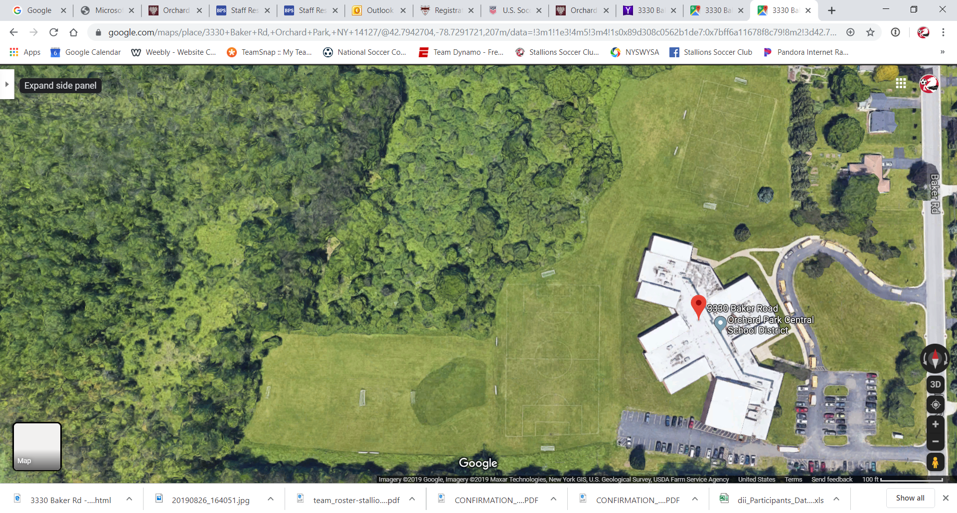
Under 10
Fire
Under 10 Revolution
Baker Road Fields
3330 Baker Rd.
Orchard Park NY 14127
Enter Only
Exit Only

