Slide 1
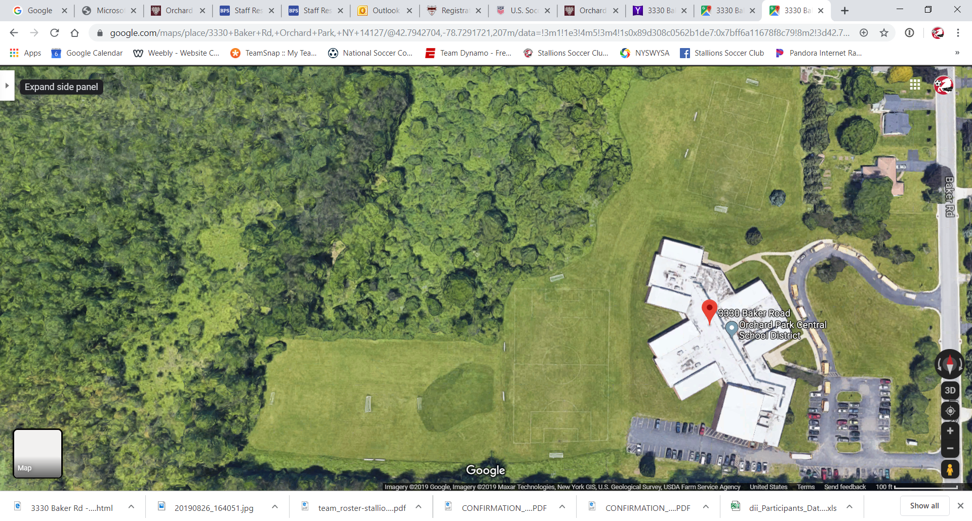
Baker Road Fields
3330 Baker Rd.
Orchard Park NY 14127
Enter Only
Under 12
Spirit
Under 12
Pride
Exit Only

