Slide 1
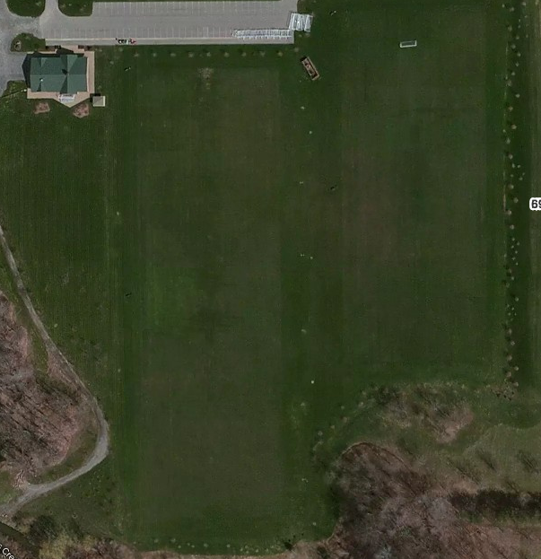
Parking
LITTLE KICKERS
Field 2 U6
Union
Field 9–U6
Fusion
U10 Galaxy
Field 3 U6
Whitecaps
Field 8 U6
Earthquak
U10 Crew
U10 Sounders
U10 City
Field 4 U6
Rapids
Field 7–U6
Red Bulls
Field 5 –U6
Impact
Field 6–U6
Dynamo
U10 Timbers
U10 United
6909 Milestrip

