Slide 1
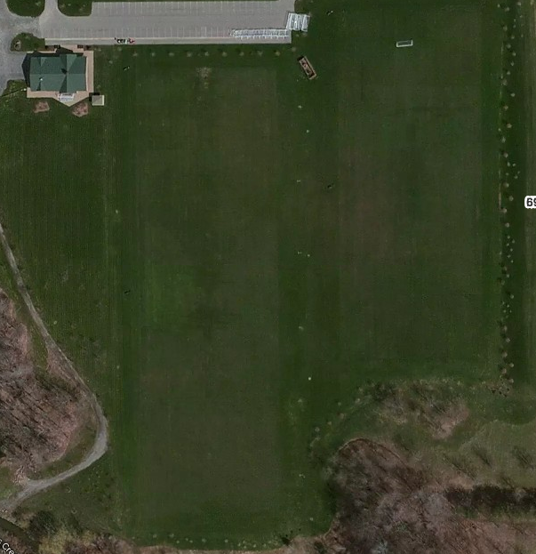
U12
Earthquakes
U12
Fire
Parking
Field 1 U8 Timbers
Field 12 U8 Crew
LITTLE KICKERS
U12
Revolution
Field 2 U8 Fire
Field 11–U8 Galaxy
Field 3 U8 Revolutio
Field 10 U8 City
U14
Blizzard
U12
Whitecaps
Field 4 U8 Dynamo
Field 9–U8 United
U14
Stallions
Field 5 –U8 Union
Field 8–U8 Sounders
Field 6 –U8 Fusion
Field 7 –U8 Rowdies
6909 Milestrip

