Slide 1
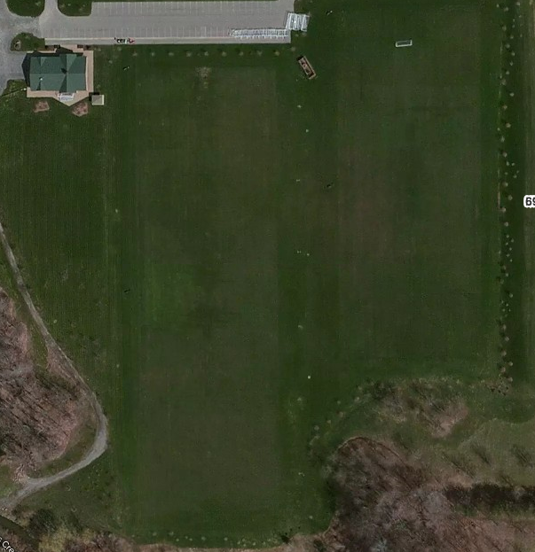
Parking
Field
1
1
12
Field
4
2
11
3
10
Field 2
4
9
5
8
Field 3
6
7
Field
6909 Milestrip

