Slide 1
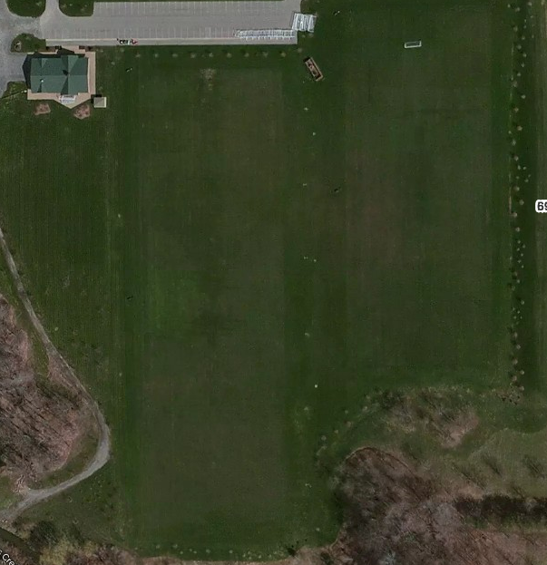
Parking
U14
Stallions
U14 Blizzard
LITTLE KICKERS
U12 Revolution
U12 Fire
U12 Pride
U12 Spirit
U12 Earthquakes
U12 Whitecaps
6909 Milestrip

