Slide 1
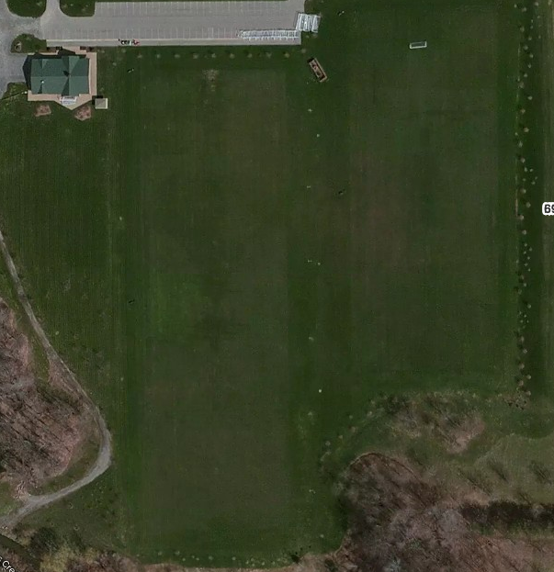
Parking
U10 Fire
U10 United
U10 Sounders
LITTLE KICKERS
U10 Crew
U10 City
U10 Revolution
U10 Galaxy
U10 Timbers
6909 Milestrip

