Slide 1
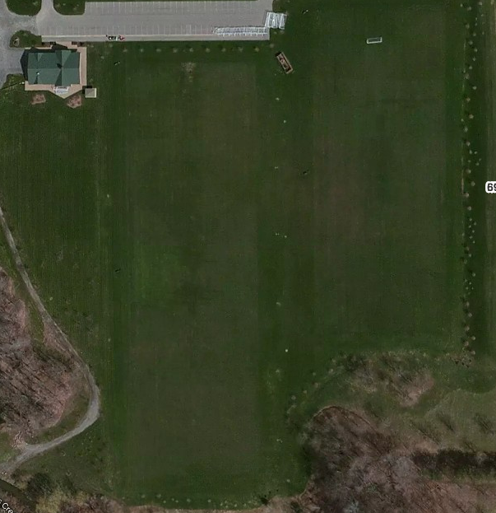
Parking
LITTLE KICKERS
Group1 Group 2 Group 3 Group 4
Under 6 5:15 to 6:15
Under 10 6:30 to 7:30
Under 8 5:15 to 6:15
Under 12 6:30 to 7:30
Tuesday
Special Olympics
6909 Milestrip

