Slide 1
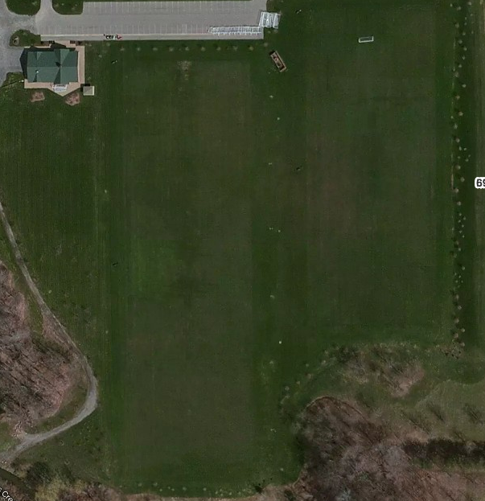
Parking
U11 and U12
U13 and U14
U9 and U10
U15 and U16
U17 and U19
6909 Milestrip

